Slide 1
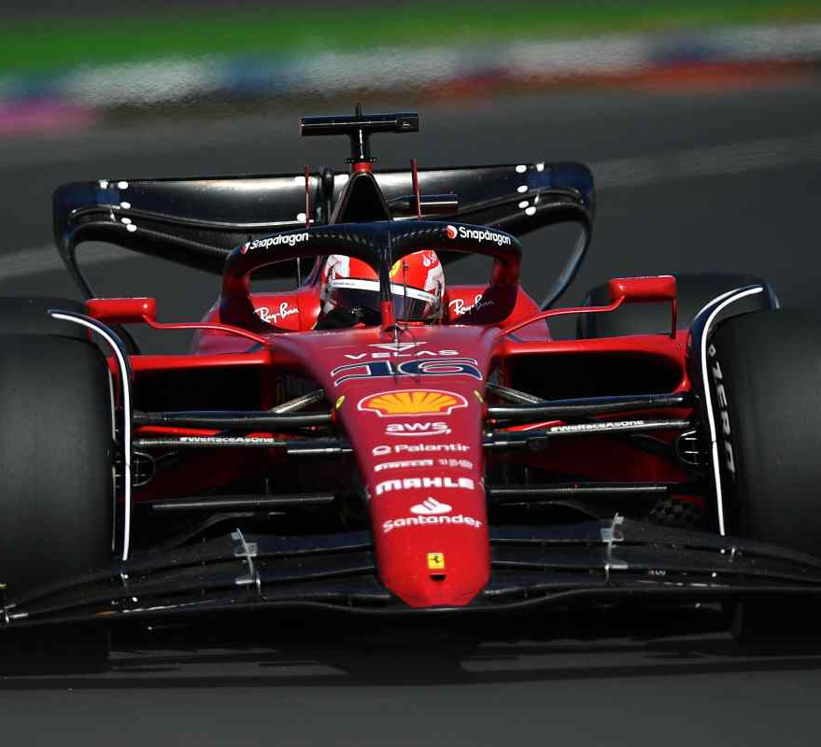
DRS OPTIMIZATION
Team members:
-Beber Luca
-Brocchieri Emanuele
-Saccani Nicola

